Slide 1
Pooja programmer,cse department
Securing Data over Internet

Slide 3
What is secure communication?
The first thing that we have to understand is that what a secure communication is. People who are new to the field of computer security tend to think that a secure communication is simply any communication where data is encrypted. However, security encompasses much more than simply encrypting and decrypting data. Most people consider the three pillars of a secure communication are.

Slide 4
1.Confidentiality 2.Integrity 3.Authenticity

Slide 5
Privacy: A secure conversation should be private. In other words, only the sender and the receiver should be able to understand the conversation.
Integrity: A secure communication should ensure the integrity of the transmitted message. This means that the receiving end must be able to know for sure that the message he is receiving is exactly the one that the transmitting end sent him.
Authentication: A secure communication should ensure that the parties involved in the communication are who they claim to be.
Authorization: Authorization refers to mechanisms that decide when a user is authorized to perform a certain task.

Slide 7
Privacy is about respecting individuals and their personal life. Internet privacy is a subcategory of data privacy. And data privacy issues can arise in response to information from a wide range of sources, such as:
healthcare records,
criminal justice investigations and proceedings,
financial institutions and transactions,
genetic material,
privacy breaches,
residence and geographic records,
user preferences using persistent cookies.
What can happen without secured network?
Cybercriminals can trade with your personal data
Free online services use your data to make money
Are the government’s intentions good?

Slide 8
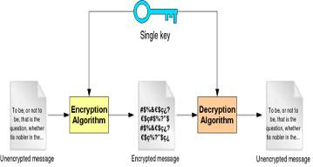
Introduction to Cryptography
Cryptography is the art of writing in secret characters. Encrypting is the act of translating a normal message to a message written with secret characters, also known as the encrypted message. Decrypting is the act of translating a message written with secret characters into a readable message, the unencrypted message.

Slide 9
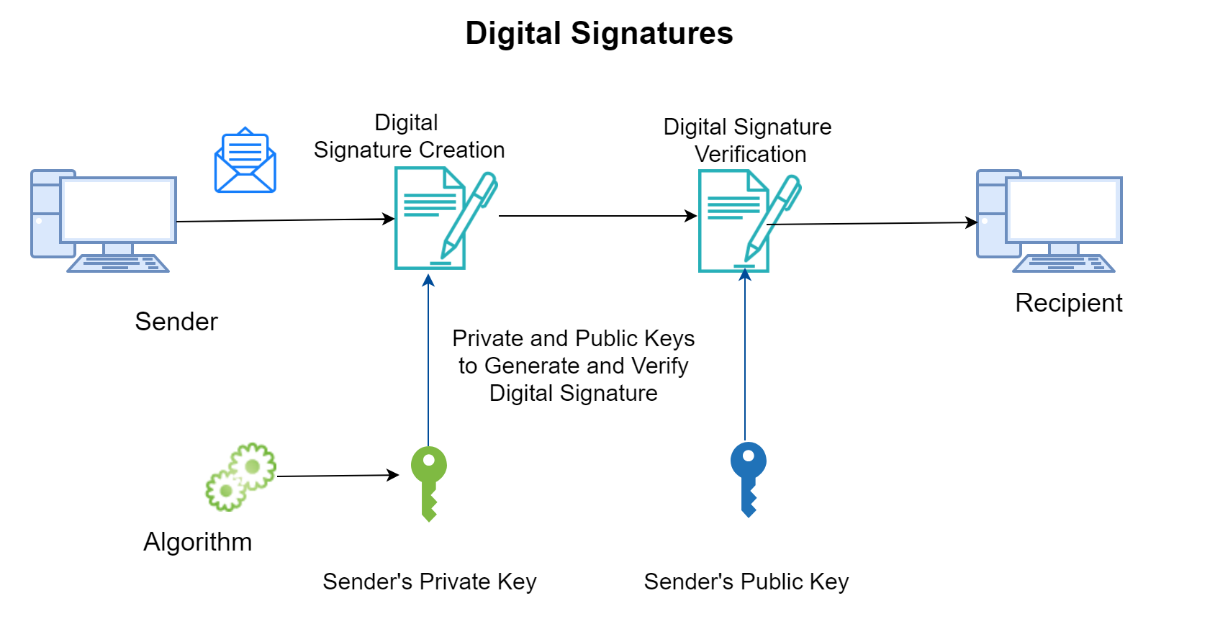
Digital Signatures
Integrity is guaranteed in public key systems by using digital signatures. A digital signature is a piece of data which is attached to a message and which can be used to find out if the message was tempered with during the conversation.

Slide 10
The digital signature for a message is generated in two steps:
A message digest is generated. A message digest is a summary of the message. The message digest is generated using a set of hashing algorithms.
The message digest is encrypted using the sender’s private key. The resulting encrypted message digest is the digital signature.
The digital signature is attached to the message and sent to the receiver. The receiver then does the following:
By using the sender’s public key, decrypts the digital signature to obtain the message digest generated by the sender.
Uses the same message digest algorithm used by the sender to generate a message digest of the received message.
Compares both message digest the one sent by the sender as digital signature and the one generated by the receiver. If they are not exactly the same, the message has been tampered with by a third party.

Slide 11
PGP ENCRYPTION

Slide 12
PGP DECRYPTION

Slide 13
SSL ENCRYPTION
SSL is primarily used to encrypt confidential data sent over an insecure network such as the Internet. In the HTTPS protocol, the types of data encrypted include the URL, the HTTP header, cookies and data submitted through forms. A web page secured with SSL has a URL that begins with “https://”.

Slide 14
SSL ENCRYPTION

Slide 15
DIGITAL CERTIFICATES
Digital certificate is an attachment to an electronic message used for security purposes. The most common use of a digital certificate is to verify that a user sending a message a who he or she claims to be, and to provide the receiver with the means to encode a reply. The main purpose of the digital certificate is to ensure that the public key contained in the certificate belongs to the entity to which the certificate was issued.

Slide 16
DIGITAL CERTIFICATION

Slide 17
HOW A CERTIFICATE IS ISSUED
Key Generation: The individual requesting certification generates key pairs of public and private keys.
Matching of Policy Information: The applicant packages the additional information necessary for the CA to issue the certificate such as proof of identity, tax ID number, e-mail address ETC.
Sending of Public Keys and Information: The applicant sends the public keys and information to the CA.

Slide 18
Verification of Information: The CA applies whatever policy rules it requires in order to verify that the applicant should receive a certificate.
Certificate Creation: The CA creates a digital document with the appropriate information and signs it using the CA’s private key.
Sending/Posting of Certificate: The CA may send the certificate to the applicant, or post it publicaly as appropriate.

Slide 19
THANK YOU

